Slide 1


MICROSOFT 365 VIRTUAL MARATHON EXCHANGE HYBRID – WHAT, WHY, AND HOW
THOMAS STENSITZKI
MVP Office Apps & Services
@stensitzki
Brought to you by
M365Conf.com | #M365CONF

Slide 2

Brought to you by
March 23-25, 2021
MGM Grand Resort
Las Vegas, Nevada, USA
M365Conf.com
#M365CONF
The SharePoint Conference is now The Microsoft 365 Collaboration Conference
Brought to you by
M365Conf.com | #M365CONF

Slide 3

ARE YOU READY FOR A RAFFLE? WE ARE GIVING AWAY 3 OCULUS QUEST ALL IN ONE!
Visit the Vendors Booth, Sessions and Watch the Videos
Submit Your Answers to Enter the Raffle
You need at least 5 correct answers then submit for a chance to win one of 3
(One in each Americas, APAC, EMEA)
https://bit.ly/m365raffle

Slide 4





CONSIDER DONATING TO THE FOLLOWING CHARITY RELIEF FUNDS: UNITED WAY: HTTPS://GIVE.UWKC.ORG/M365VM INTERNATIONAL MEDICAL CORPS: HTTPS://BIT.LY/MEDICALCORPSFUND
10% OF FUNDS FROM SPONSORS GO TO SUPPORT COMMUNITY RELIEF. FOR MORE INFORMATION WRITE TO INFO@M365VIRTUALMARATHON.COM

Slide 5










THANK YOU TO ALL OUR GENEROUS SPONSORS

Slide 6


LET ME INTRODUCE MYSELF…
Thomas Stensitzki, Germany
Expert and owner of Granikos GmbH & Co. KG
MVP Office Apps & Services, MCT Regional Lead, Author
Exchange Server, Microsoft Teams, Microsoft 365
LinkedIn: https://linkedin.com/in/thomasstensitzki Twitter: @stensitzki
Brought to you by
M365Conf.com | #M365CONF

Slide 7
I WILL TELL YOU SOMETHING ABOUT…
What is Exchange Hybrid?
Why do you need Exchange Hybrid?
How do you implement Exchange Hybrid?
Sources and links
Brought to you by
M365Conf.com | #M365CONF

Slide 8
“Implementing Exchange Hybrid is simple.”
- Undisclosed Exchange consultant
Brought to you by
M365Conf.com | #M365CONF

Slide 9


What is Exchange Hybrid?
Exchange Hybrid – High Level Overview
Exchange Hybrid Variants
Classic / Modern Hybrid
Brought to you by
M365Conf.com | #M365CONF

Slide 10
Microsoft Exchange Online
Built on 24 Years of Market Leading Innovation
Exchange Online
Most secure
Most productive
Lowest TCO
99.9% uptime guarantee, unparalleled compliance standards, advanced data, threat and identity protection
Enables full collaboration experience with SharePoint, Microsoft Teams, and Outlook, faster search, seamless mobile experience, intelligent calendaring, 100GB mailboxes and unlimited archives, and more
No more migrations, no more patching, lower cost per user, FastTrack migration services, reduced IT overhead, seamless hybrid means cloud at your pace

Slide 11
What is Exchange Hybrid?
Trusted relationship between an on-premises Exchange Organization and Exchange Online
Hybrid connections for mail flow (SMTP), and client access (HTTPS) for hybrid functionality
Hybrid Configuration Wizard (HCW) activates and configures the hybrid mode of operation
Microsoft 365
Hybrid Configuration
Exchange Online
On-Premises Exchange Organization

Slide 12
Exchange Hybrid Benefits
Free Busy lookups
No recreating of Outlook Profiles
Mailbox migrations without user interruption
Seamlessly connect to on-premises & Exchange Online
One Global Address List
Secure Mail Flow between on-premises & Exchange Online
Hybrid Modern Authentication
Cloud based archiving
And much more…
Brought to you by
M365Conf.com | #M365CONF

Slide 13
Exchange Hybrid | Two Variants – Three Modes
Hybrid Configuration
Classic
Express
Minimal
Modern
Minimal
Full
Full

Slide 14
Classic Full Hybrid
Microsoft 365
Active Directory Hybrid with Azure AD Connect
Exchange Hybrid enabled
SMTP Connection between On-Premises and Exchange Online
Separate hostname (e.g., smtp365.company.de)
Additional public IP address
TLS certificate for hostname
Edge Transport Role in perimeter network (A)
Alternatively, direct inbound connection (B)
Inbound HTTPS connection to Client Access Service
Published by Reverse Proxy
Additional public IP address
Outbound HTTPS connections to Exchange Online
Exchange Server
Hybrid Configuration
Exchange Online
Azure AD
B
A
HTTPS
SMTP
Perimeter Network
Company LAN
On-Premises Exchange Organization

Slide 15
Modern Full Hybrid
Microsoft 365
Active Directory Hybrid with Azure AD Connect
Exchange Hybrid enabled
SMTP Connection between On-Premises and Exchange Online
Separate hostname (e.g., smtp365.company.de)
Additional public IP address
TLS certificate for hostname
Edge Transport Role in perimeter network (A)
Alternatively, direct inbound connection (B)
Outbound HTTPS connections to Exchange Online
Exchange Hybrid-Agent (Exchange Online to Exchange on-premises communication)
Exchange Server
Hybrid Configuration
Exchange Online
Azure AD
B
A
HTTPS
SMTP
Perimeter Network
Company LAN
On-Premises Exchange Organization

Slide 16


Exchange Hybrid – The Differences
Full
Full classic hybrid configuration, Exchange server published to the internet (SMTP/HTTPS) → permanent hybrid operation
Minimal
Hybrid configuration, without rich coexistence to migrate all on-premises mailboxes to Exchange Online → temporary hybrid operation for a few weeks / months
Express
Hybrid configuration, with Azure AD Connect Express settings, to migrate all on-premises mailboxes to Exchange Online → temporary hybrid operation for a few days / weeks
Full
Full Modern Hybrid configuration, for new hybrid setups based on Hybrid Agent deployment, with reduced hybrid functionality → permanent hybrid operation
Minimal
Modern Hybrid configuration, to migrate all on-premises mailboxes to Exchange Online → temporary hybrid operation for a few weeks / months

Slide 17
Why do you need Exchange Hybrid?
Exchange Hybrid Benefits
Exchange Hybrid and Microsoft Teams
Brought to you by
M365Conf.com | #M365CONF

Slide 18
Why do you need Exchange Hybrid?
Coexistence between on-premises Exchange Organization & Exchange Online
Mailbox migration to/from Exchange Online
Microsoft Teams with on-premises mailboxes
Transition from on-premises Exchange to Exchange Online
Optimal migration experience for end users
Centralized mail flow for use of on-premises mail solutions and cloud-hosted mailboxes
Gateway-based S/MIME de-/encryption, disclaimer, archiving, journaling, …
Hybrid mail flow providing Exchange relay functionality for on-premises legacy applications and devices
No access to the internet
No support for TLS connection encryption
No support for user authentication

Slide 19
Exchange Hybrid and Microsoft Teams
On-Premises Exchange Server 2016 / 2019 hybrid endpoint
Microsoft Teams backend uses AutoDiscover v2
Client Access Endpoint for Microsoft Teams backend services
Always run latest Exchange Server cumulative update
Use Third-Party TLS-certificate
Enable Hybrid Modern Authentication
AutoDiscover DNS resource records for SMTP domains

Slide 20
How to implement Exchange Hybrid
Office 365 Hybrid Configuration Wizard
Set up HCW
Brought to you by
M365Conf.com | #M365CONF

Slide 21
Exchange Hybrid Requirements
Know the different hybrid variants and modes
Know your target operation mode for Exchange hybrid
Have your on-premises Exchange organization in good shape
Latest cumulative updates installed
Verify inbound connectivity to your Exchange organization using Remote Connectivity Analyzer
Have required IP addresses & DNS host names set up
Have Edge TLS certificates installed on internal Exchange Servers for selection by HCW
Not enabled for any Exchange service

Slide 22
Hybrid Configuration Wizard
Exchange Server Requirements
Exchange 2010 SP3 + latest Update Rollup
Exchange 2013 CU1 or later
Exchange 2016 and Exchange 2019
→ Supported modern Exchange Server setup requires latest CU (or N-1)
Click-2-Run Setup
https://aka.ms/HybridWizard
Ensure that .application file extension is mapped to Internet Explorer
Current Version 17.x
Uninstall HCW 16.x first
Verify that WinRM service is running and not controlled by GPO
https://aka.ms/HybridWizard

Slide 23
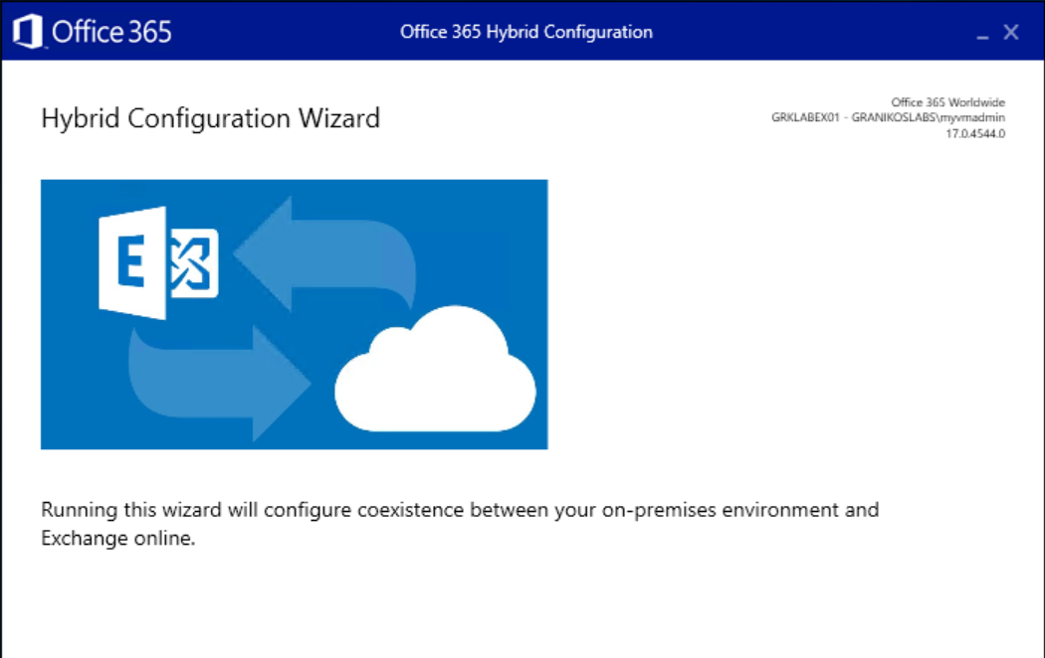
Hybrid Configuration Wizard
Note the HCW version information
HCW is updated regularly

Slide 24
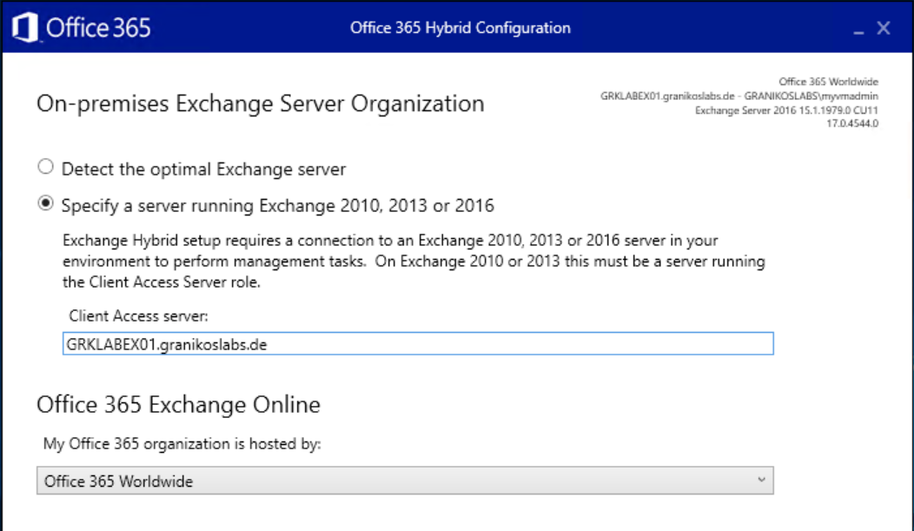
Hybrid Configuration Wizard
Optimal Exchange Server detected by HCW
Specify a CAS server manually
Select Office 365 target infrastructure

Slide 25
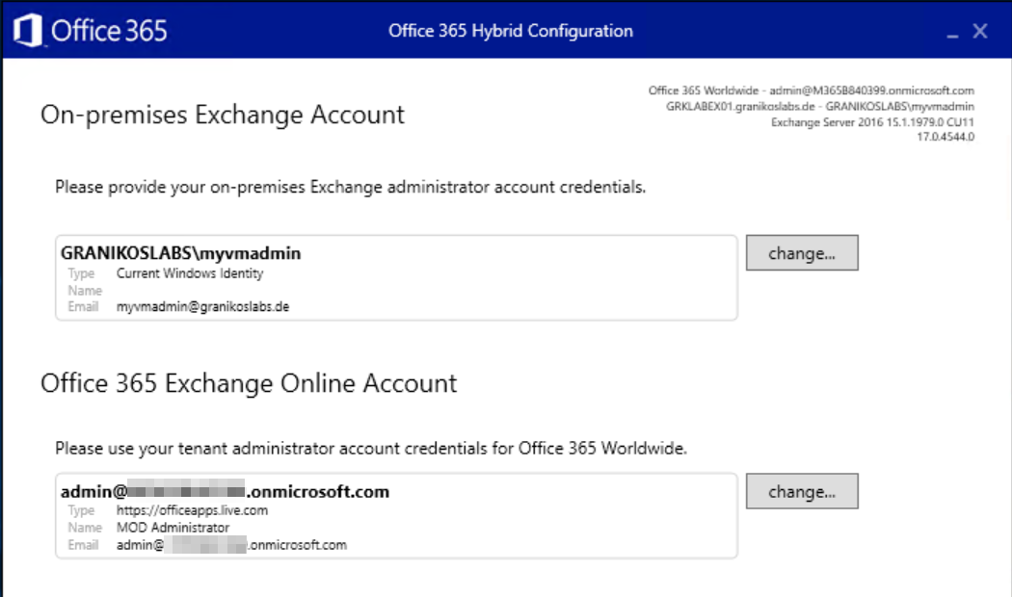
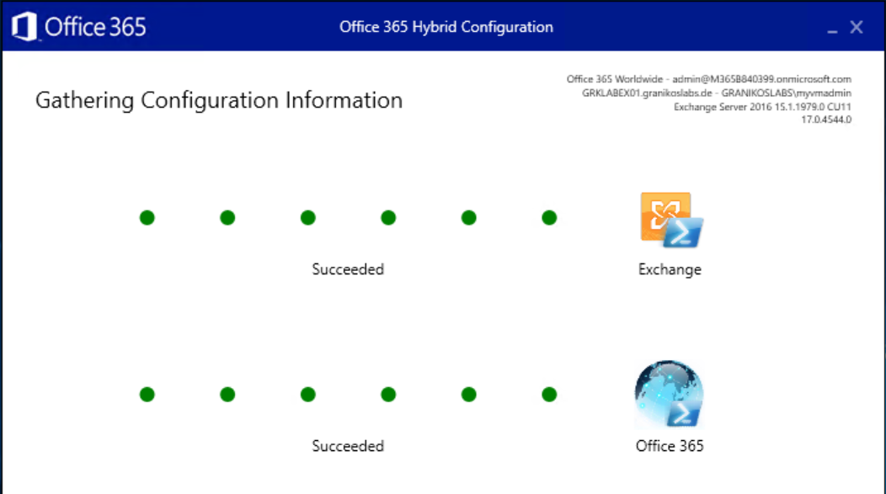
Hybrid Configuration Wizard
Connect to on-premises Exchange and Exchange Online
Adjust credentials as needed
Check, if WinRM allows Basic Authentication

Slide 26
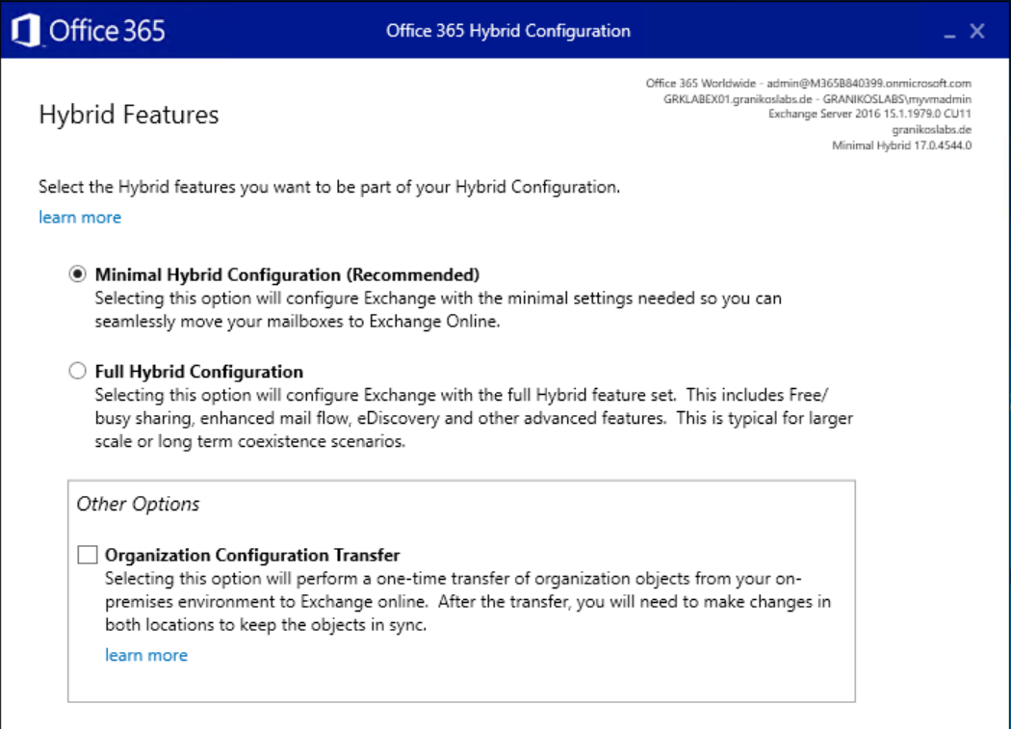
Hybrid Configuration Wizard
Select hybrid features
Minimal Hybrid
Full Hybrid
Enable Organization Configuration Transfer
One-time transfer of selected configuration objects

Slide 27
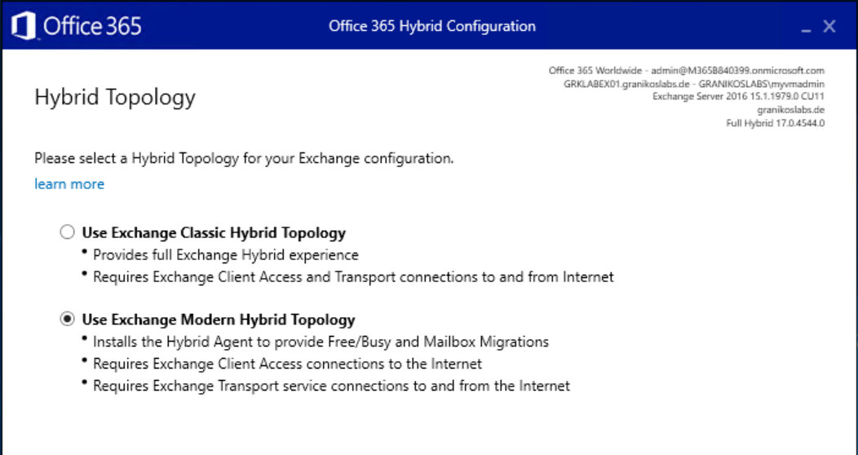
Hybrid Configuration Wizard
Select Hybrid Topology
Classic Hybrid
Modern Hybrid

Slide 28
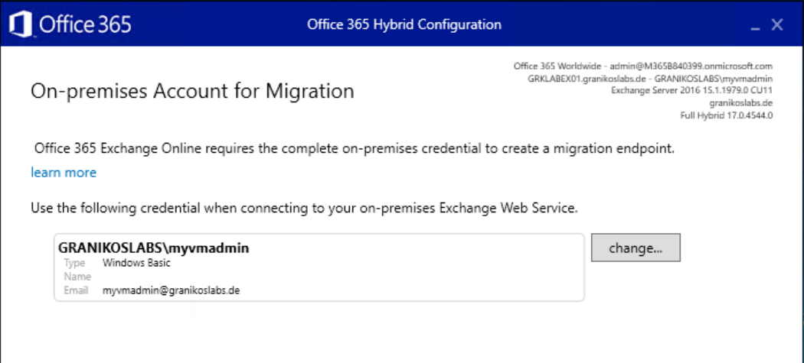
Hybrid Configuration Wizard
Configure credentials for on-premises Exchange Web Service Endpoint
Used for mailbox migrations

Slide 29
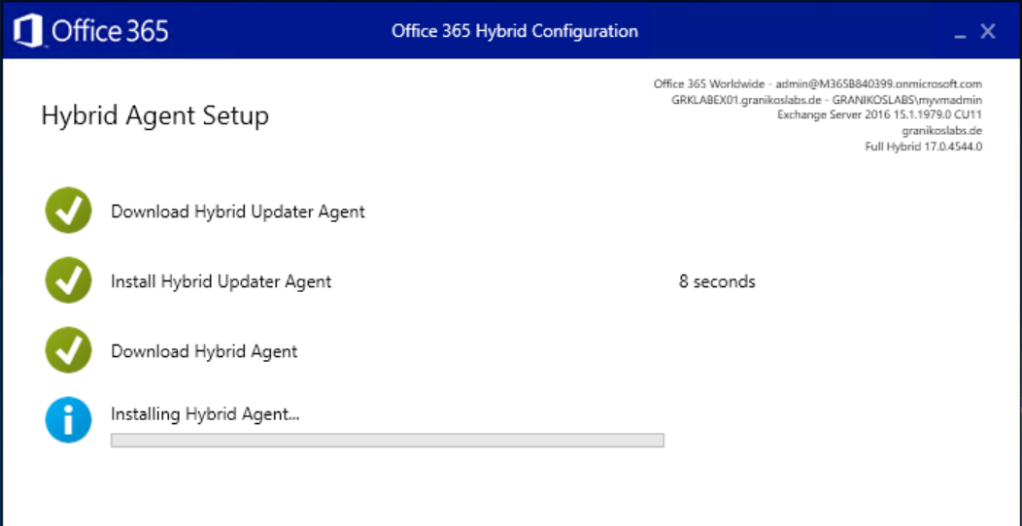
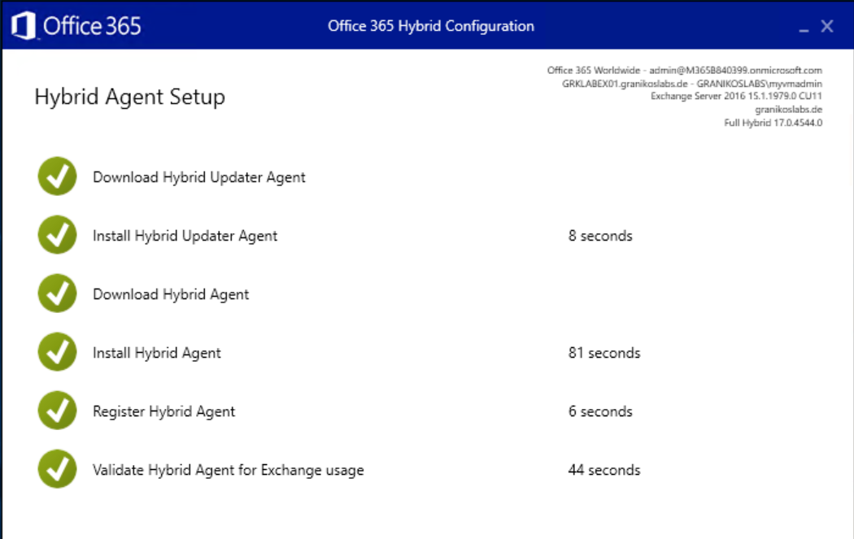
Hybrid Configuration Wizard
Hybrid Agent Setup starts automatically
Download and install of Hybrid Updater
Download and install of Hybrid Agent

Slide 30
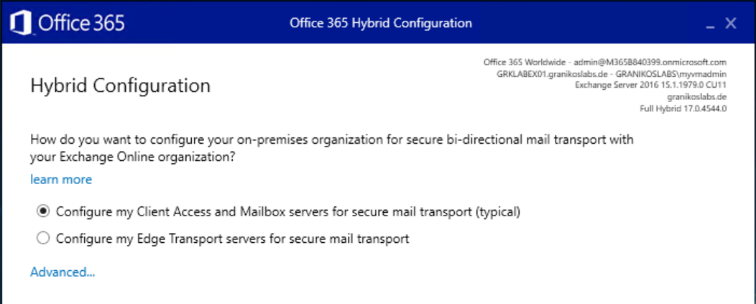
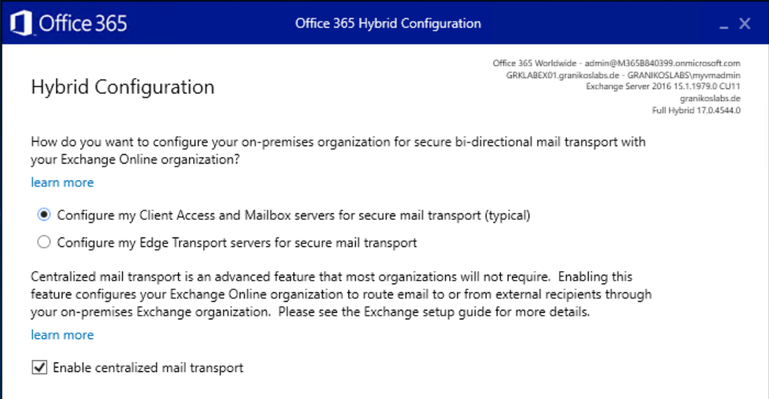
Hybrid Configuration Wizard
Configure hybrid mail flow
Direct to/from internal Exchange Servers
Edge Transport Servers in perimeter network
Centralized mail flow
Route all mail flow to/from Exchange Online via on-premises Exchange Organization

Slide 31
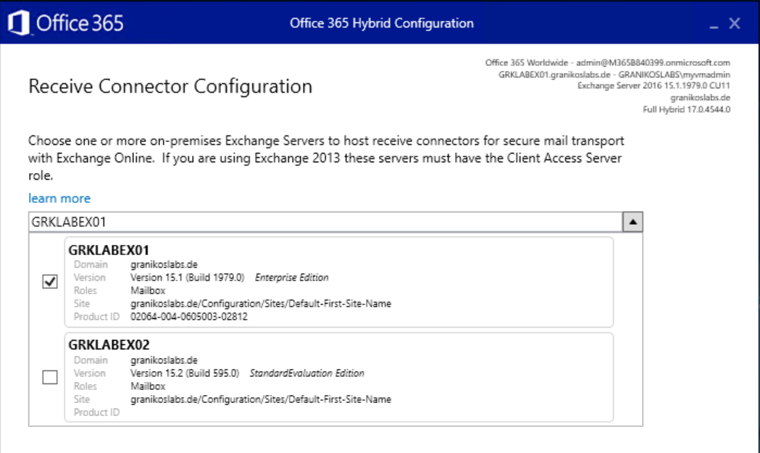
Hybrid Configuration Wizard
Select Exchange server used for receiving email messages from Exchange Online
Select the Exchange Server published to the Internet
HCW configures the receive connector

Slide 32
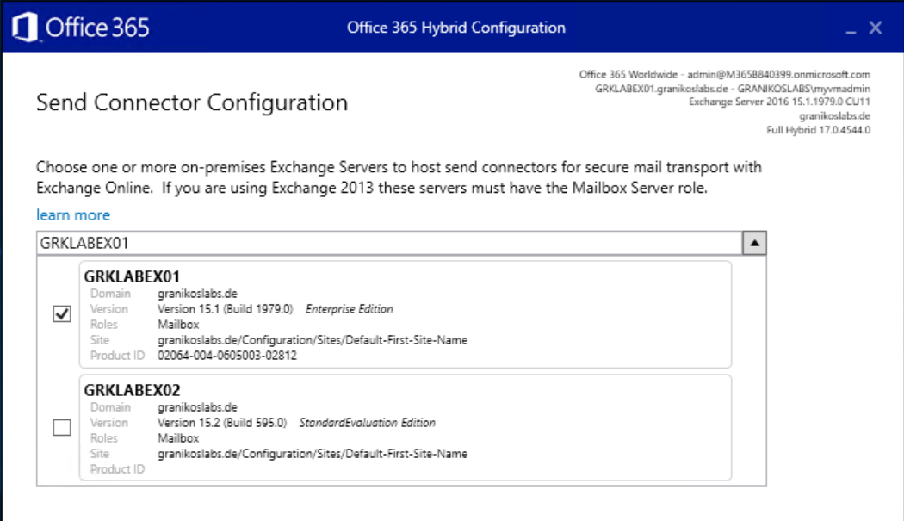
Hybrid Configuration Wizard
Select Exchange server for sending email messages from the on-premises Exchange Organization to Exchange Online
HCW configures Send Connectors
Server needs outbound connectivity to Exchange Online

Slide 33
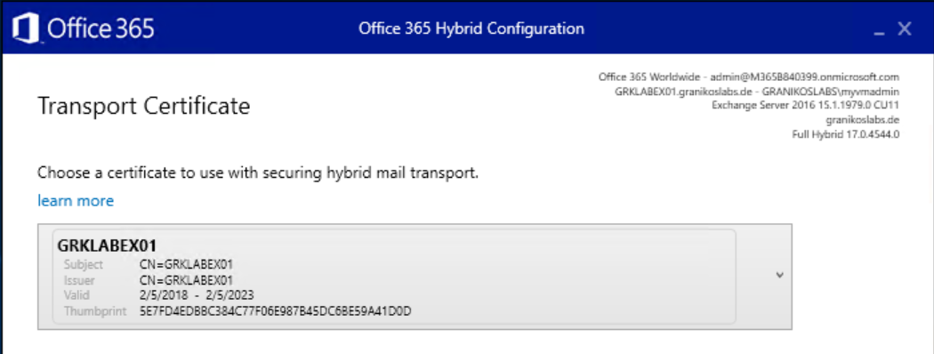
Hybrid Configuration Wizard
Select TLS certificate to secure the trusted mail flow between on-premises Exchange and Exchange Online
With Edge Transport
Ensure that the dedicated TLS certificate is installed in the certificate store of one of the internal Exchange servers
Do NOT enable the TLS certificate for any Exchange service

Slide 34
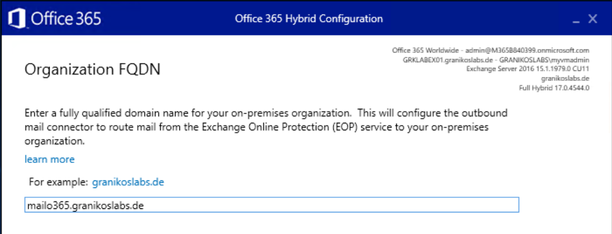
Hybrid Configuration Wizard
Enter the external FQDN of the Exchange Organization
Hostname should match TLS certificate

Slide 35
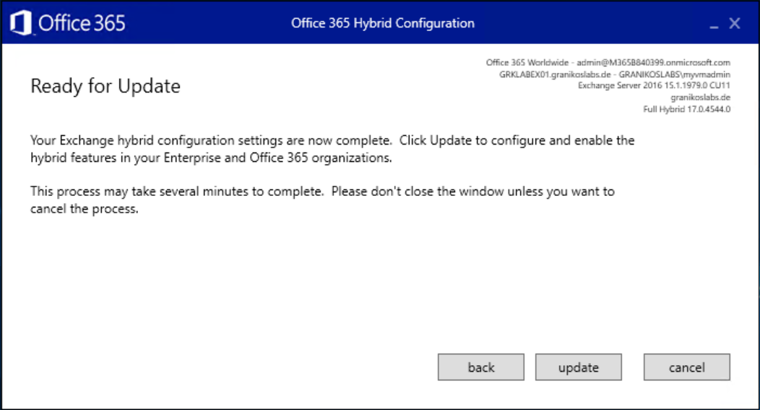
Hybrid Configuration Wizard
Update and wait
If it fails
HCW provides access to full log files
All configuration steps documented
Remote Connectivity Analyzer to check inbound connectivity
Issues
Remote connectivity → Firewall, Proxy, DNS
WinRM Windows service configuration issues

Slide 36
Do not forget
Exchange Server 2010
End of Support
October 13th 2020

Slide 37


Contact
Thomas Stensitzki
Expert | Owner Granikos GmbH & Co. KG
MVP | Office Apps & Services Twitter: @Stensitzki LinkedIn: https://linkedin.com/in/thomasstensitzki
Blog DE: http://Blog.Granikos.eu Blog EN: http://JustCantGetEnough.Granikos.eu MVP Blog: https://blogs.msmvps.com/thomastechtalk

Slide 38


THANK YOU FOR JOINING US!
DO YOU HAVE ANY QUESTIONS?
Speaker feedback
https://bit.ly/M365VMSpeakerFeedback
Event feedback
https://bit.ly/M365VMFeedback

Slide 39
Resources
Exchange Server Hybrid Deployments
Hybrid Deployment Prerequisites
Hybrid Configuration Wizard FAQs
How to configure Exchange Server on-premises to use Hybrid Modern Authentication
How Exchange and Microsoft Teams interact
Configure OAuth authentication between Exchange and Exchange Online organizations
Demystifying and troubleshooting hybrid mail flow: when is a message internal?
Remote Connectivity Analyzer

